Slide 1
Michelangelo Buonarroti
Novicov Christian
25.01.15

Slide 2
Who was he?
Michelangelo di Lodovico Buonarroti Simoni (6 March 1475 – 18 February 1564), commonly known as Michelangelo was an Italian sculptor, painter, architect, poet, and engineer of the High Renaissance who exerted an unparalleled influence on the development of Western art.

Slide 3
What is he famous?
Michelangelo was considered the greatest living artist in his lifetime, and since has been held to be one of the greatest artists of all time. A number of his works in painting, sculpture, and architecture rank among the most famous in existence

Slide 4
St.Peter This sculpture was made in 1481 to complete the cathedral in Milan.
The most impressive works by michelangelo buonarroti
David is a masterpiece of Renaissance sculpture created between 1501 and 1504.
The Moses (c. 1513–1515) is a sculpture housed in the church of San Pietro in Vincoli in Rome.

Slide 5
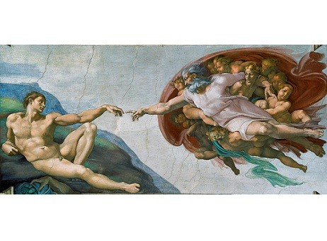
Michelangelo created and pictures and here are some of them.
The Doni Tondo or Doni Madonna, sometimes called The Holy Family, is the only finished panel painting by the mature Michelangelo to survive.
Creation of Adam.
This is a fragment of fresco Sistine Chapel ceiling.
The Entombment
is an unfinished painting of the placing of the body of Jesus in the garden tomb

Slide 7
Thank you for watching!

