Slide 1
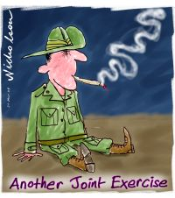

Slide 2
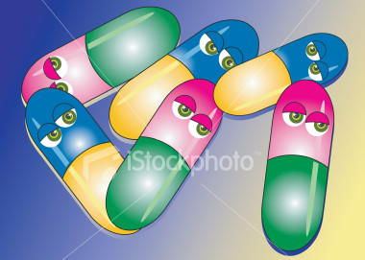
A DRUG IS ANY SUBSTANCE OTHER
THAN FOOD WHICH CHANGES THE
WAY THE BODY OR MIND FUNCTIONS.

Slide 3





Types of drugs
Stimulants (uppers) – Speed up the brain and central nervous system. Examples are caffeine (coffee, tea) nicotine (cigarettes), amphetamines, speed, cocaine and diet pills.

Slide 4


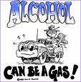
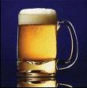
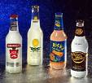
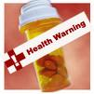
Types of drugs
Depressants (downers) – Slow down the brain and central nervous system. Examples are alcohol, beer, wine, vodka, gin etc heroin, tranquilizers, sleeping pills.

Slide 5





Types of drugs
Hallucinogens – These drugs
alter the user’s state of consciousness. (Distort auditory and visual sensations) Examples are LSD, ecstasy, magic mushrooms, marijuana.

Slide 6
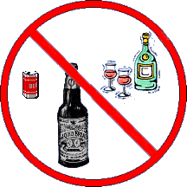
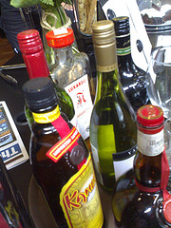
Alcohol
Physical Effects
Co-ordination is impaired, clumsiness, slower reflexes
High blood pressure, damage to the heart
Liver damage
If drinking when pregnant, FASD
Life threatening when mixed with other drugs
Mental and Emotional
Behave in ways that you normally wouldn’t
Increase in aggressive and violent behaviour
Problems with school and learning

Slide 7
NICOTINE
What it does to your body, brain and behavior
depression
lung cancer
lung diseases
heart disease
skin becomes thinner and wrinkled

Slide 8
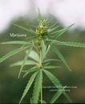
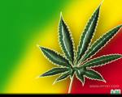
MARIJUANA
Marijuana and cigarette smoke have some of the same cancer-causing substances.
Benzopyrene (cancer-producing agent) higher in marijuana
400 chemicals in marijuana smoke affect lungs, throat and esophagus

Slide 9
CLUB DRUGS
Certain drugs have become popular among teens and young adults at dance clubs and raves.
MDMA/ECSTASY
KETAMINE
ROHYPNOL
GHB

Slide 10
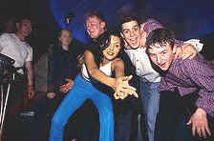
ECSTASY
Effects
Feeling of sadness
Anxiety, Depression
Memory Difficulties
Paranoia
Nervousness
Insomnia
Drug cravings
Increased touch of sense
Suppresses need to eat or sleep
Moist skin or dry mouth

Slide 11
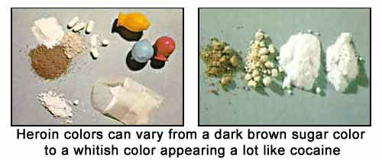
HEROIN
Processed from morphine – obtained from opium poppy
“downer” affects brain’s pleasure systems – interferes with brains ability to feel pain

Slide 12
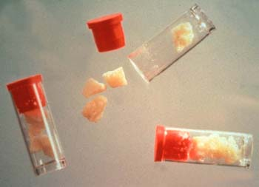
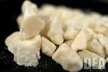

Cocaine + CRACK
Cocaine is a stimulant drug-more alert and energetic
Cocaine is a white powder comes from the leaves of coca plant
Can be one of the hardest drugs to quit

Slide 13

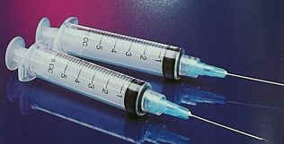
Substance abuse and society
What are the effects of substance abuse on society?
Spread of diseases such as HIV/AIDS and Hepatitis C through sharing needles, or having unprotected sex

Slide 14
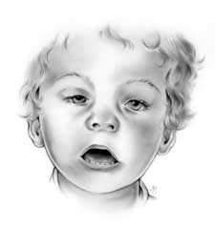
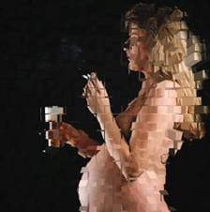
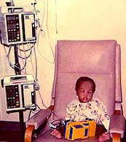
Substance abuse and society
Effects on unborn children or other complications from drug use

Slide 15
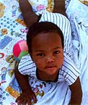
EFFECTS OF DRUG USE ON CHILD
Miscarriages
Premature birth
Low birth weight
Birth defects
Developmental problems
A baby’s health problems, if caused by a drug will continue to grow as the child grows.

Slide 16
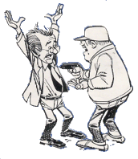


Substance abuse and society
CRIME
drug possession
drug use
drug trafficking
drug manufacturing
theft
break and enter
robbery
motor vehicle theft

Slide 17
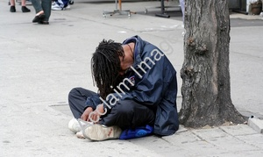
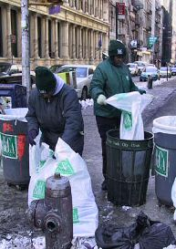
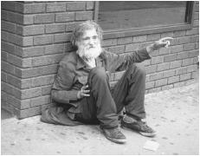
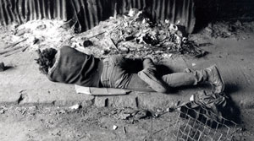
Substance abuse and society
HOMELESSNESS

Slide 18
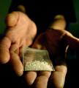


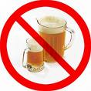
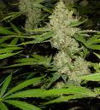




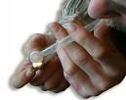

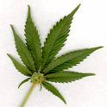
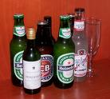



WHY DO PEOPLE USE DRUGS?

Slide 19

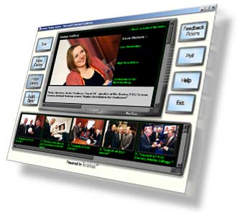
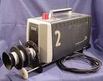
MEDIA

Slide 20
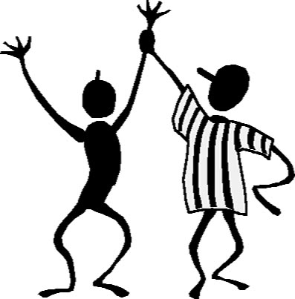
POSITIVE
REINFORCEMENT

Slide 21
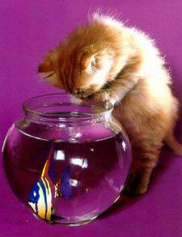

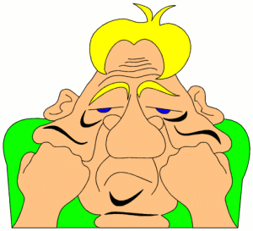
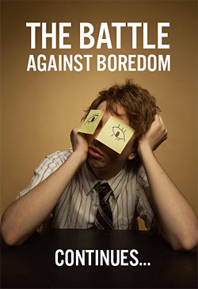


??
????
BOREDOM
CURIOSITY

Slide 22

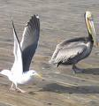



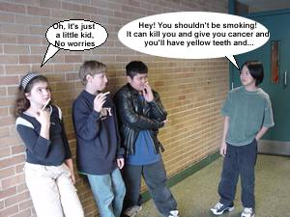
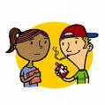

EMOTIONAL PRESSURE

Slide 23



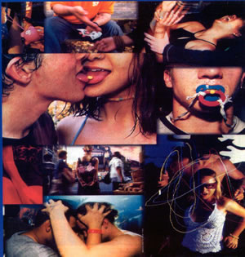


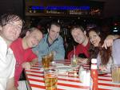

CELEBRATIONS

Slide 24
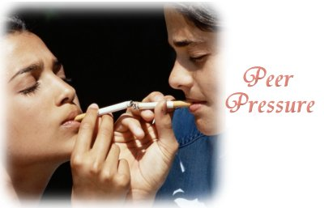


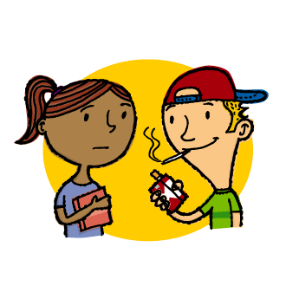



PEER PRESSURE

Slide 25

Remember:
Do not use a drugs!

